Slide 1
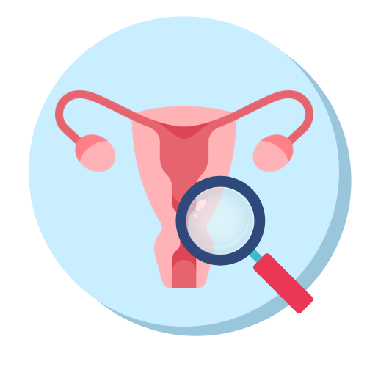
Endometriosis Early Detection
Daniel Moshe | Adi Haber
Notes:
Adi
We came to present the progress of our research

Slide 2
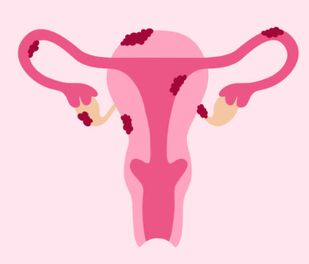
What Is Endometriosis?
A chronic medical condition where endometrial tissue grows outside the uterus and adheres to other organs, mainly in the pelvic region.
Main symptoms include chronic pain, infertility, fatigue, and sometimes even anxiety and depression.
Endometriosis is prevalent mostly in women of reproductive age (15-49). Researchers say 10% of this population is affected - about 190 million patients worldwide.
Notes:
ADI

Slide 3
Workshop Overview
Analyzing medical data found in UK Biobank using machine learning tools.
Research Question
Creating a Cohort
Defining a research question regarding risk factors of a certain medical condition.
Creating a cohort of patients relevant to the research question and cleaning it.
Extracting Features
Creating a Model
Examining various medical studies and scientific articles to find features. Then extracting them from the UKB.
Creating a machine learning model to get a prediction for the research question and repeating the process to improve it.
Notes:
Risk factors
Biobank structure

Slide 4
Our Research Question
What are the key risk factors associated with the development and diagnosis of Endometriosis?
Notes:
ADI
Risk factors
Biobank structure

Slide 5
Reasons for Choosing this Subject
Endometriosis is under-researched, with significant gaps in understanding its causes, risk factors, and optimal diagnostic methods.
The diagnosis process is long and tedious.
There is a lack of awareness to this illness, both from the general population and medical professionals.
Notes:
ADI
- in the UK, more than half of people do not know about endometriosis, including 62% of women between the age of 16 and 24 (BMC Medicine. Shining a light on endometriosis: time to listen and take action.)

Slide 6
The Problem
Diagnosis dificulty
Effects of delay
Current state
Endometriosis is very hard to diagnose.
Adhesions are hard to see using imaging.
Diagnosis time averages at 7 years.
Intensifies symptoms.
Lowers quality of life.
Causes incurable reproductive health challenges and infertility.
Conventional diagnostic methods include invasive procedures.
Doctors have subjective assessments.
Notes:
ADI
60% of women dealing with endometriosis will experience a delay of seven years before getting a diagnosis.
This prolonged delay intensifies symptoms, lowers overall quality of life, and contributes to enduring reproductive health challenges.
Conventional diagnostic methods, predominantly reliant on invasive procedures and subjective assessments, further complicate the diagnostic process.

Slide 7
Proposed Solution
Diagnosing Endometriosis by analysing UK Biobank patient data.
Developing a machine-learning model for precise Endometriosis detection using these features extracted from the UK Biobank.
Notes:
Adi
- Short explanation about the UKB

Slide 8
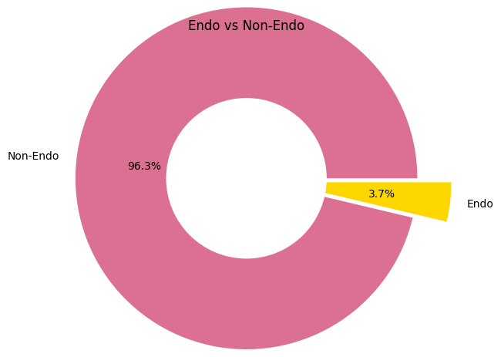
~270,000
~10,000
Exploring our Data
Female patients in the biobank
Patients diagnosed with Endometriosis
Sparse Features
Mixed Data Types
Many features are sparse, making feature extraction challenging.
UKB contains both categorical and numerical data, requiring separate processing.
Notes:
Daniel
- How many of the features are sparse

Slide 9
Data Filtering
~500,000 Patients
~270,000 Female Patients
~10,000 Diagnosed with Endo
Sample Equal amount of non-diagnosed patients
Final dataset: ~20,000 Patients
Notes:
DANIEL

Slide 10
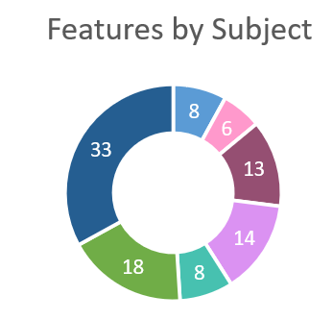
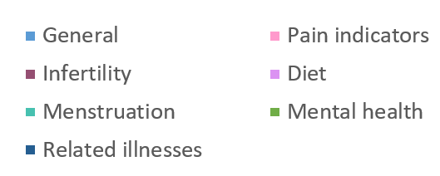
Feature Selection
Created a list of 100 features by feature id, from the UK Biobank Showcase.
Features include:
General data | Pain indicators
Related diseases | Diet
Mental health | Menstruation
Infertility and pregnancy difficulties
Notes:
DANIEL

Slide 11
Data Preprocessing
Categorical Features
Feature Engineering
Mainly including dates and icd-10 codes. We converted them to one-hot encoding.
Added new features based on raw data, like number of icd-10 diagnoses and estrogen exposure.
Feature Correlations
Missing Data
Analyzed feature correlations and eliminated highly correlated features to reduce redundancy and improve model performance.
Removed features with more than 90% missing data. Remaining missing values were addressed through mean imputation.
Notes:
DANIEL

Slide 12
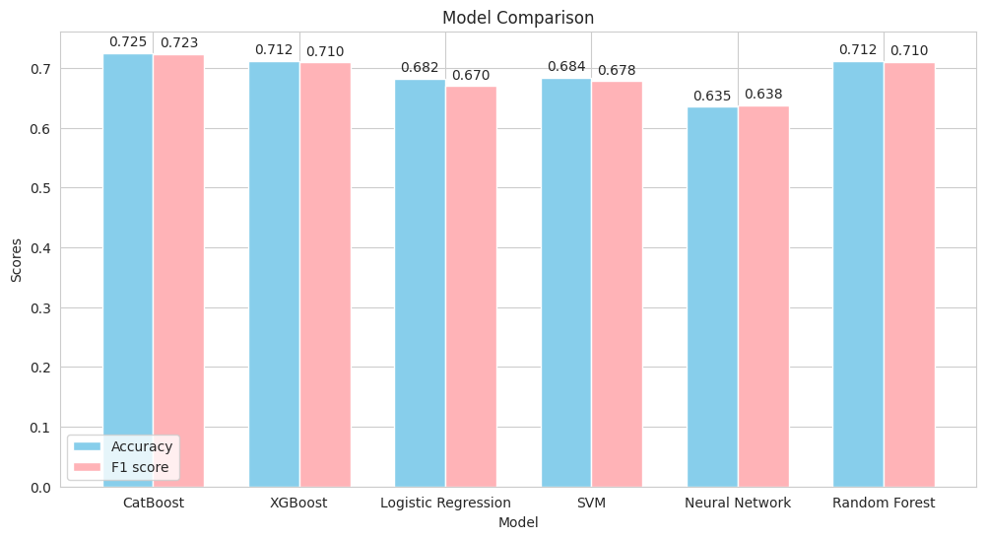
Model Selection
Notes:
DANIEL

Slide 13
Dilemmas and Challenges
Remote Code
Data Imputation
There was no easy way to run interactive python on the remote server, so we used Jupyter remote kernels with SSH tunneling.
After choosing to use CatBoost, we realized there is no improvement to results after imputation, so we skipped it in the final model.
Generic Code
Validation Set
We aimed to write generic code and classes that are adaptable for use in similar projects, whether for biobank usage or general ML usage.
We considered using a validation set for tuning model hyperparameters, but opted for cross-validation, as our dataset is limited in size.
Notes:
DANIEL
Technical challenges with the server
Running vscode
Choosing data split and using cross val
Imputing or not?

Slide 14

R&D Workflow
Playground_cohort.ipynb
Parse Database
Preprocess Features
Create Cohort
Parse_database.py
Features_preprocess.py
Create_cohort.py
Tune Hyperparameters
Choose Model
Split Data
Best_model.ipynb
Model_selection.py
Predict
Rank Risk factors

Slide 15
Roadmap
01
02
03
04
Choosing and defining reaserch question
Research Edometriosis and find features
Code scripts for data extractions
Extract initial dataset
05
06
07
08
Explore and cleanse data
Feature engineering
Choosing model
Evaluation of the model
Notes:
Next is feature engineering
The uKB offers a lot of data, one of the files is hospital diagnoses
Endo is hard to diagnose, and its symptoms are very similar to other conditions. This, combined with the diagnosis delay, causes many mis-diagnoses along the way
Thus, we assume there will be a correlation between endo and the number of diagnoses.

Slide 16
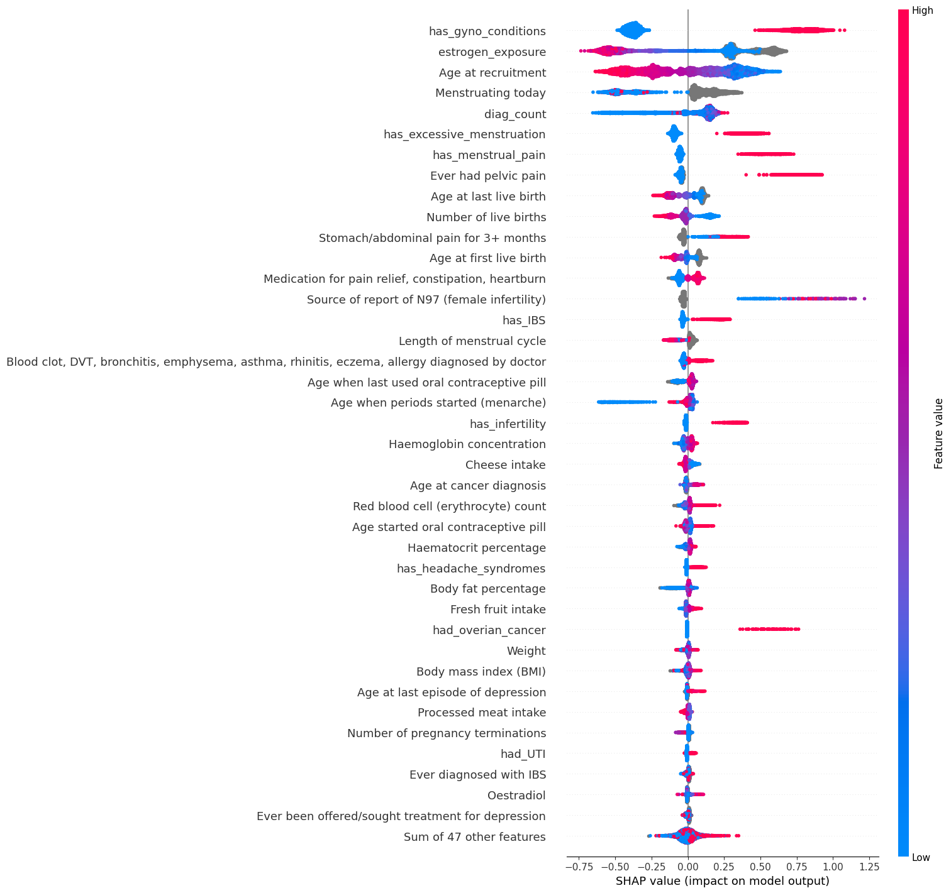
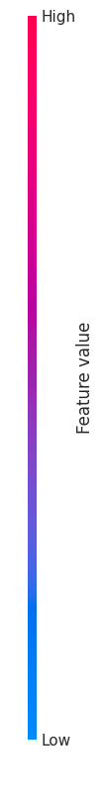
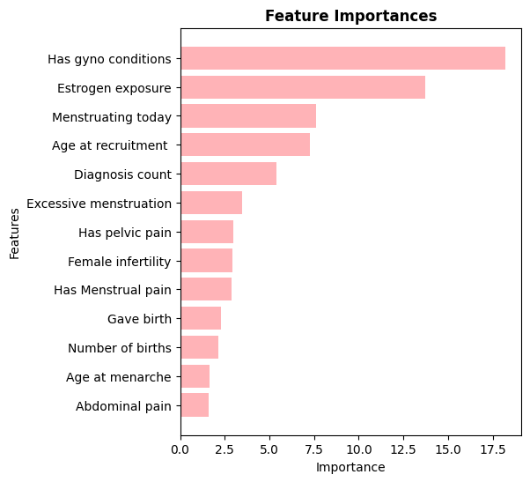
Result Analysis
Predictions:
Accuracy: 0.73
F1 Score: 0.72
Notes:
Adi
SHAP is a framework used to interpret the output of machine learning models.

Slide 17
Model Limitations
Ages of Patients
Diversity of Patients
Balanced dataset
Endometriosis is usually discovered at late 20s or early 30s.
Biobank average diagnosis age is 42.
Data might not truly represent patients today.
Biobank does not contain a diverse population.
Mainly comprised of white British population.
We chose a 50% ratio of diagnosis in our cohort.
In the general population, 10% have endo.
In healthcare settings, ratio probably differs.
Notes:
ADI
Data leakage: when your training data contains information about the target, but similar data will not be available when the model is used for prediction.

Slide 18
Conclusions
Impact
Application
Future Work
Raising awareness to Endometriosis.
Potentially reducing diagnosis time and improving patient outcomes.
Model can be applied in clinical settings to assist healthcare professionals in diagnosing Endometriosis earlier.
Exploring the model's application to other related conditions.
Expanding the dataset to include more diverse populations.
Notes:
DANIEL
Data leakage: when your training data contains information about the target, but similar data will not be available when the model is used for prediction.

Slide 19
Thank you
Endometriosis Early Detection | Daniel Moshe, Adi Haber

